Slide 1
Welcome to Hello World Series
Popular Distributed Version Control Systems

Slide 2
In last tutorial...
We discussed – Advantages of Distributed Version Control Systems?

Slide 3
In this tutorial...
We will list some of the most popular Distributed Version Control Systems.

Slide 4
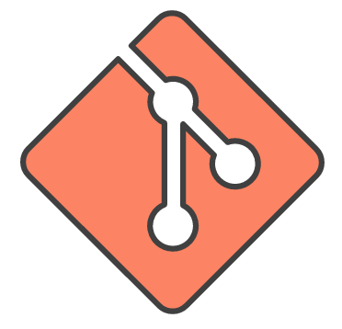
Some well known DVCS - GIT
GIT - https://git-scm.com
Created by Linus Torvalds in 2005 for development of the Linux kernel.
Like the Linux kernel, Git is free software distributed under the terms of the GNU GPL V2.

Slide 5
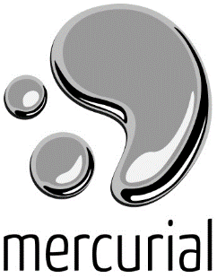
Some well known DVCS - Mercurial
Mercurial - https://www.mercurial-scm.org
Mackall first announced Mercurial on 19 April 2005.
Mercurial is released as free software under the terms of the GNU GPL v2
In 2013, Facebook started using Mercurial.
This project started a few days after another project called Git, initiated by Linus Torvalds

Slide 6

Some well known DVCS - Bazaar
Bazaar - http://bazaar.canonical.com
Version 1.0 of Bazaar was released in December 2007 and 2.7.0 in Feb 2016.
The Bugzilla project retired Bazaar in favor of git in March 2014 for multiple reasons, one of them being the impression that Bazaar was almost dead.

Slide 7

Some well known DVCS - Darcs
Darcs Advanced Revision Control System - http://darcs.net
Darcs is a distributed version control system created by David Roundy.
After writing an initial version of Darcs in C++, the Haskell version was written in Autumn 2002 and released to the public in April 2003.
Darcs 2.0 was released in April 2008
Darcs has been criticized on the grounds of performance.

Slide 8
Coming up Next
What is GIT
Notes:
In Slide Show mode, click the arrow to enter the PowerPoint Getting Started Center.

